Slide 2
Crypto MP3/CP1

Slide 3
What’s in MP1 Checkpoint 1?
1.1.1: Hex/Decimal/Binary Conversions (2 points)
1.1.2: Encryption/Decryption
Substitution Cipher (3 points)
Decrypting AES (3 points)
Breaking a Weak AES Key (3 points)
Decrypting a Ciphertext with RSA (3 points)
1.1.3: Hashing
Avalanche Effect (3 points)
Weak Hashing Algorithm (3 points)
Due on 9-13-2017, we will run the autograder on Saturday, Tuesday to give you some feedback for checkpoint 1.
Start early and take advantage of this.

Slide 4
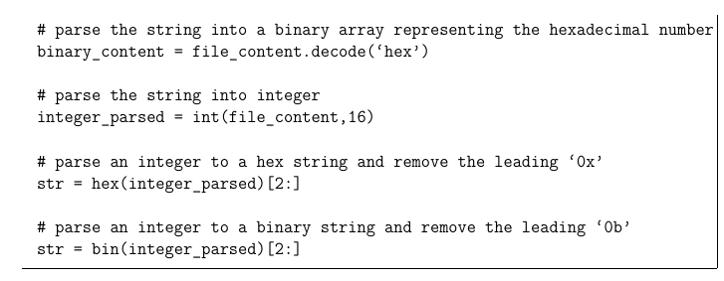
Hex/Decimal/Binary Conversion
String : abcd HexString: 61626364
Convert a hex string to decimal number.
Convert the same hex string to binary number.

Slide 5
Substitution Cipher
Retrieve the original text given a substitution key and a ciphertext.
Every character in an alphabet is replaced by a corresponding character from the key
Two alphabet example:
Replace letter A with letter Z in the original text
Replace letter B with letter F in the original text
The substitution will contain “ZF”
If plain text is ABA, the ciphertext will be ZFZ

Slide 6
Decrypting AES
Intro to AES
Symmetric cipher - same key is used to encrypt and decrypt
Block Cipher: operate on fixed-size chunks
You need IV to initialize the first block, and key to encrypt.
Decrypt a ciphertext using IV and Key.
We recommend PyCrypto library for this part.

Slide 7
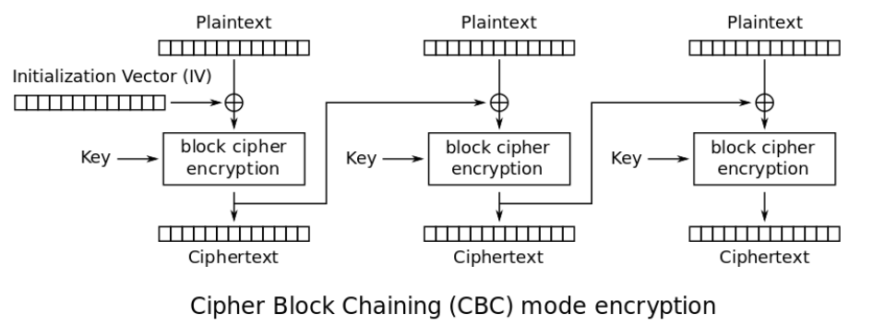
AES CBC

Slide 8
Breaking a Weak AES Key
Unlike the previous problem, you don’t have the AES Key for this problem.
However, the search space is reduced from 2^256 to 2^5.
Approach: bruteforce

Slide 9
Decrypting a Ciphertext with RSA
Quick Intro to how RSA works
Public key encryption:
Key pair: public and private key
Public key: public knowledge
Private key: confidential
Messages encrypted with one key can only be decrypted by the other key
Encryption: c ≅ m^e (mod n), where m is the message, e is the encryption key, n is the modulus
Decryption: m ≅ c^d (mod n)
c, d, n are given to you. You need to compute m.
Don’t overthink this problem.
Decrypting a ciphertext given private key, and module.
You cannot use third party library to use this part.
You can only use pow function from python math library

Slide 10
Avalanche Effect
Demonstrate the avalanche effect on the SHA-256 function.
Compute hamming distance between two SHA-256 hashes.
Hamming distance example:
Two numbers 3 and 5, their binary representations are 0011 and 0101.
Do an XOR operation: 3 ^ 5 = 0110, just count how many ones you have.
Hamming distance between 3 and 5 is 2.

Slide 11
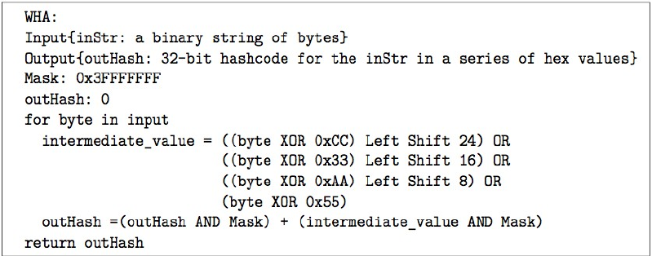
Weak Hashing Algorithm
Given a weak hashing algorithm, we ask you to find a string that produces the same hash as the string in your 1.1.3.2_input_string.txt
Approach: Work out a small example by hand.

Slide 12
What’s in MP3 Checkpoint 2?
Checkpoint 2 is worth ⅚ of your total mp1 grade.
Problems:
Length extension attack
MD5 collisions
Padding Oracles
Mining your P’s and Q’s

